Slide 1
Welcome
To
Project - 4
Feature Extraction and Price Prediction for Mobile Phones
Name – Mohd Jubair Khan
Date – 10 – 04 - 2024

Slide 2
Abstract
Processed_Flipdata is a dataset containing information about various mobile phone models. The dataset includes features such as the model name, color options, storage capacity (Memory), RAM size, battery capacity (Battery_), rear camera specifications (Rear Camera), front camera specifications (Front Camera), presence of AI lens (AI Lens), mobile height (Mobile Height), processor details (Processor_), and price (Prize).
This dataset can be used for analyzing trends in mobile phone specifications and pricing. Researchers and analysts can explore correlations between features like RAM, camera quality, and price, helping manufacturers and consumers understand market preferences and make informed decisions.

Slide 3
Content
1. Introduction
2. Objectives
3. Methods
4. Results
5. Conclusions
Chapter - 1
1. Introduction
The Processed_Flipdata dataset contains detailed information about mobile phone models, including specifications such as color options, storage capacity (Memory), RAM size, battery capacity (Battery_), camera specifications (Rear Camera and Front Camera), presence of AI lens (AI Lens), mobile height (Mobile Height), processor details (Processor_), and price (Prize). This dataset is a valuable resource for analyzing trends in mobile phone features and pricing.
Mobile phones have become an integral part of modern life, with consumers often faced with a wide array of choices when selecting a new device. Understanding the factors that influence consumer preferences and purchasing decisions is crucial for manufacturers and retailers alike. By analyzing this dataset, researchers and analysts can gain insights into the relationships between different features of mobile phones and their prices, helping to identify market trends and inform product development strategies.

Slide 4
Chapter - 2
2. Objectives:
(i). Feature Analysis:
Explore the relationship between mobile phone features (Memory, RAM, Camera specifications, etc.) and their prices to identify key factors influencing pricing
(ii). Market Trends:
Analyze historical pricing data to understand trends in mobile phone pricing over time and identify factors driving these trends.
(iii). Consumer Preferences:
Investigate how consumer preferences for certain features (e.g., AI Lens, Battery_) impact mobile phone prices and market demand.

Slide 5
(iv). Competitive Analysis:
Compare mobile phone models based on their specifications and pricing to assess competitiveness in the market.
(v). Predictive Modeling:
Develop machine learning models to predict mobile phone prices based on their features, providing insights for pricing strategies and product positioning.
(vi). Insights for Manufacturers:
Provide actionable insights for mobile phone manufacturers to enhance product development and marketing strategies based on market demand and competitive landscape.

Slide 6
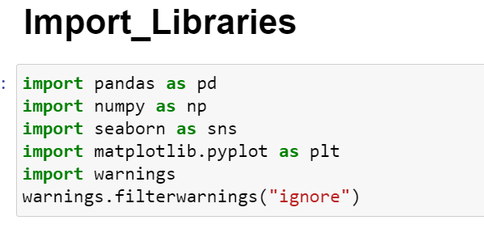
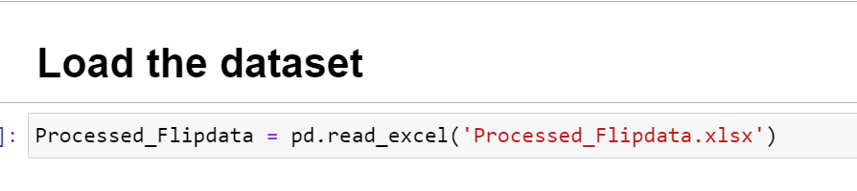
Chapter - 3
3. Methods
(i). Data Exploration:
Load the dataset:
To load the Feature Extraction and Price Prediction for Mobile Phones dataset into a Pandas DataFrame, Load the dataset provided in a CSV or Excel format into a Pandas DataFrame to facilitate easy manipulation and analysis. Using Python Pandas Library.

Slide 7
(ii). Data Preprocessing:
Cleaning the data is an essential step in the data analysis process, particularly for mobiles phone analysis. It involves preparing the dataset by addressing missing values, removing duplicate entries, and fixing any anomalies or inconsistencies. This ensures that the data is accurate and reliable for further analysis.
(a). Handling Missing Values:
Missing values can occur due to various reasons such as data entry errors or incomplete records. To handle missing values, you can:
Use isnull() method to identify missing values in the dataset.
Use fillna() method to replace missing values with appropriate values, such as the mean, median, or mode of the column.
Alternatively, you can use the dropna() method to remove rows with missing values if they are not critical for your analysis.

Slide 8
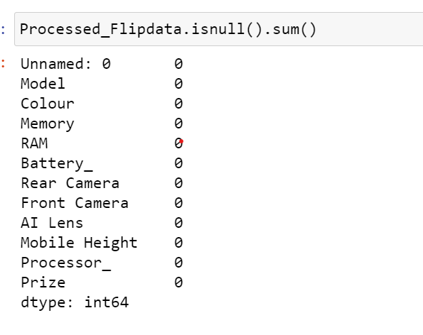
(b). Removing Duplicates:
Duplicate entries can skew the analysis results. To remove duplicates, you can:
Use the duplicated() method to identify duplicate rows in the dataset.
Use the drop_duplicated() method to remove duplicate rows and keep only unique entries.

Slide 9
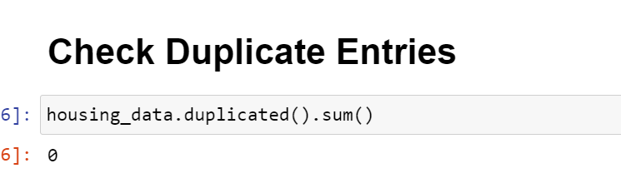
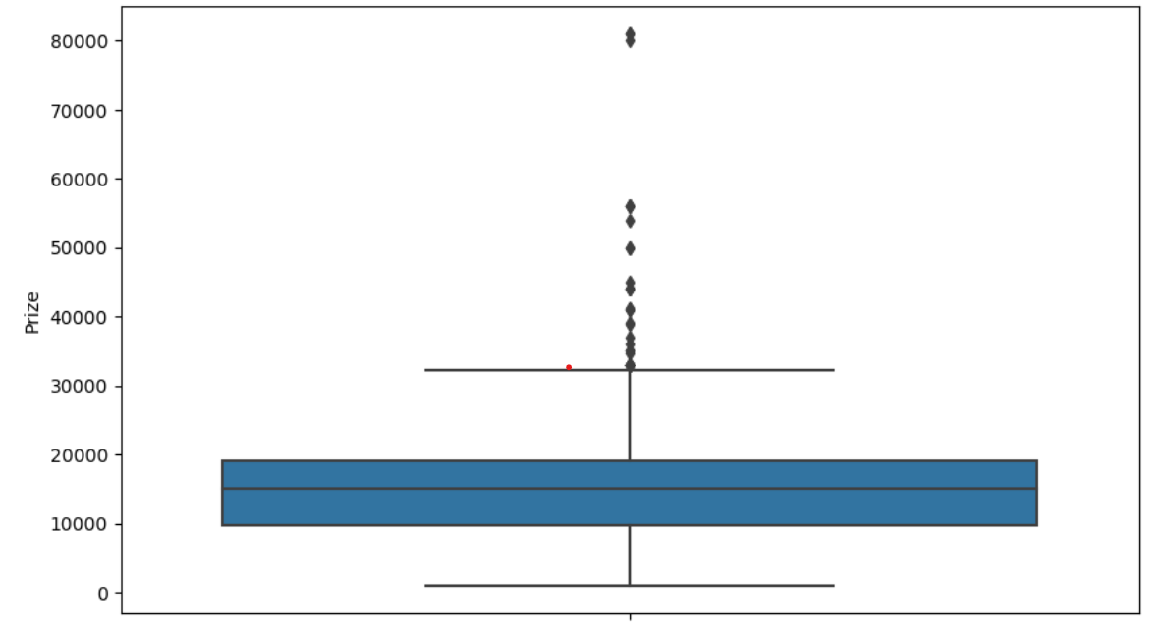
(C). Outliers:
Boxplot: Use a boxplot to visualize the distribution of each numerical variable (Memory, RAM, Battery_, Rear Camera, Front Camera, Mobile Height, Prize). Points outside the whiskers of the boxplot can be considered outliers.

Slide 10
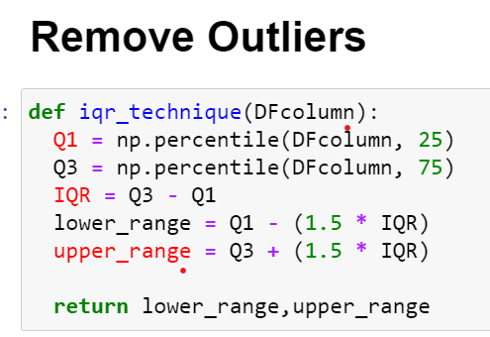
QR (Interquartile Range): Calculate the IQR for each numerical variable and identify outliers as points that fall below Q1 - 1.5 * IQR or above Q3 + 1.5 * IQR, where Q1 and Q3 are the first and third quartiles, respectively.

Slide 11
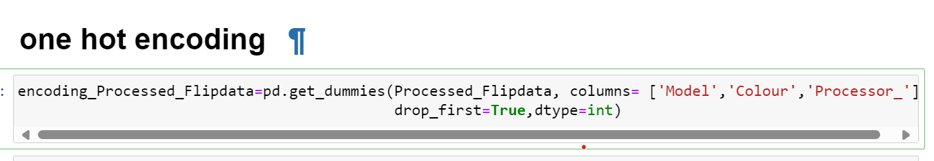
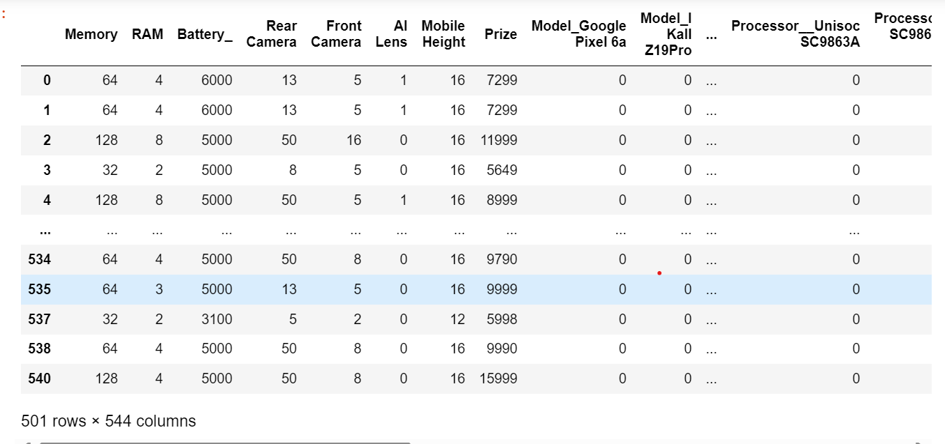
(d). one-hot encoding:
To use one-hot encoding for categorical variables in the Processed_Flipdata dataset (such as 'Model' and 'Colour'), you can convert these categorical variables into a format that machine learning models can interpret. Here's how you can do it using pandas.’get_dummies’ function

Slide 12
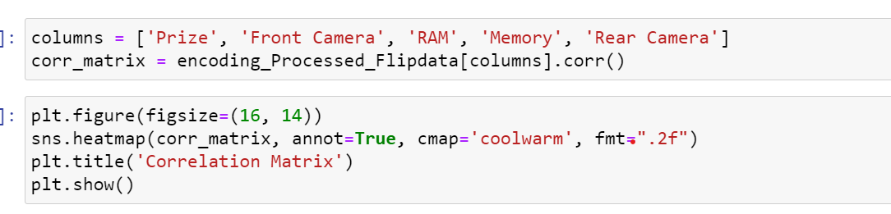
(iii). Feature Extraction:
To find the most relevant features that strongly affect the price of mobile phones in the Processed_Flipdata dataset, you can use various feature extraction techniques. Here's a general approach:
(a). Statistical Methods:
Calculate correlations between each feature ('Model', 'Colour', 'Memory', 'RAM', 'Battery_', 'Rear Camera', 'Front Camera', 'AI Lens', 'Mobile Height', 'Processor_') and the target variable ('Prize'). Features with high absolute correlation coefficients are likely to be more relevant.

Slide 13
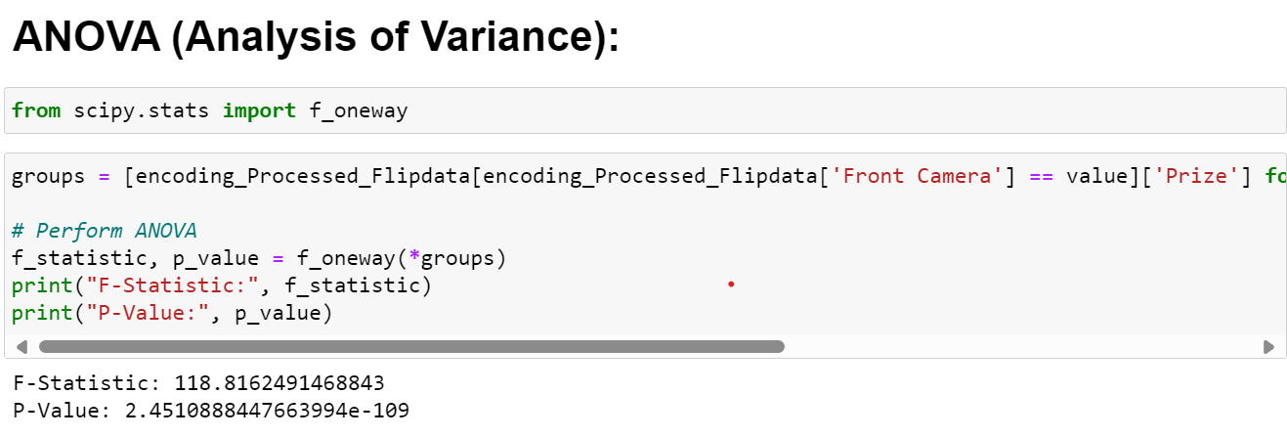
Use statistical tests such as ANOVA (Analysis of Variance) or t-tests to determine the significance of each feature with respect to the target variable.

Slide 14
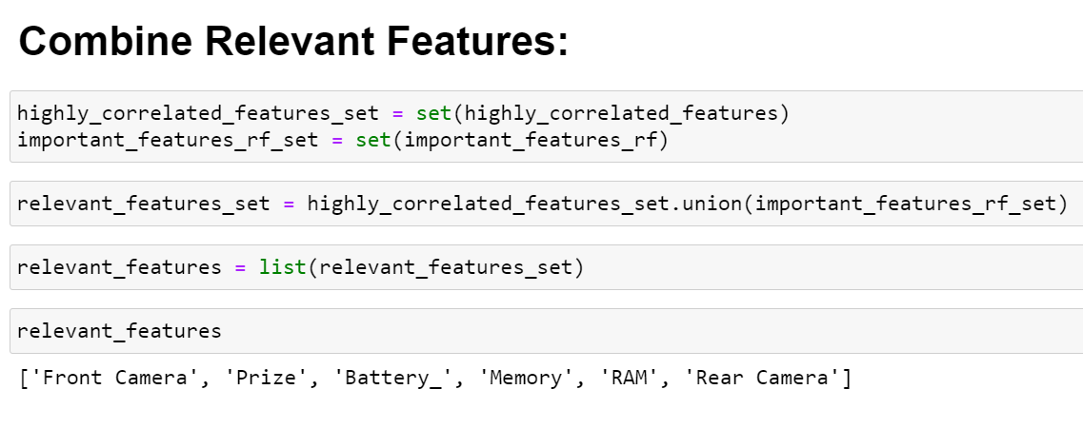
(b). Visualizations:
Create scatter plots, box plots, or heatmaps to visualize the relationship between each feature and the target variable.
Use pairplots or correlation matrices to visualize the relationships between multiple features and the target variable.

Slide 15
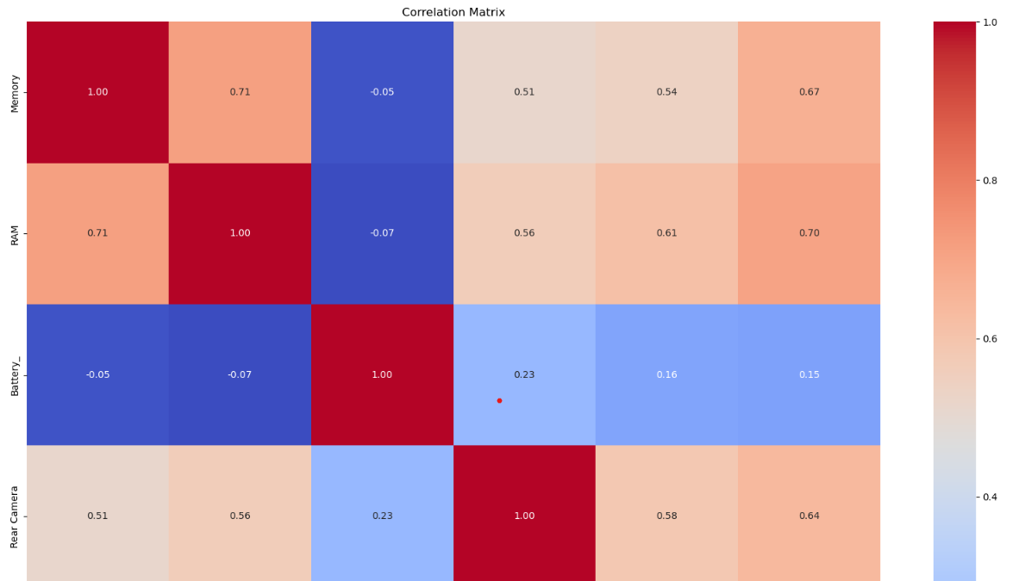
(1). Heatmap:

Slide 16
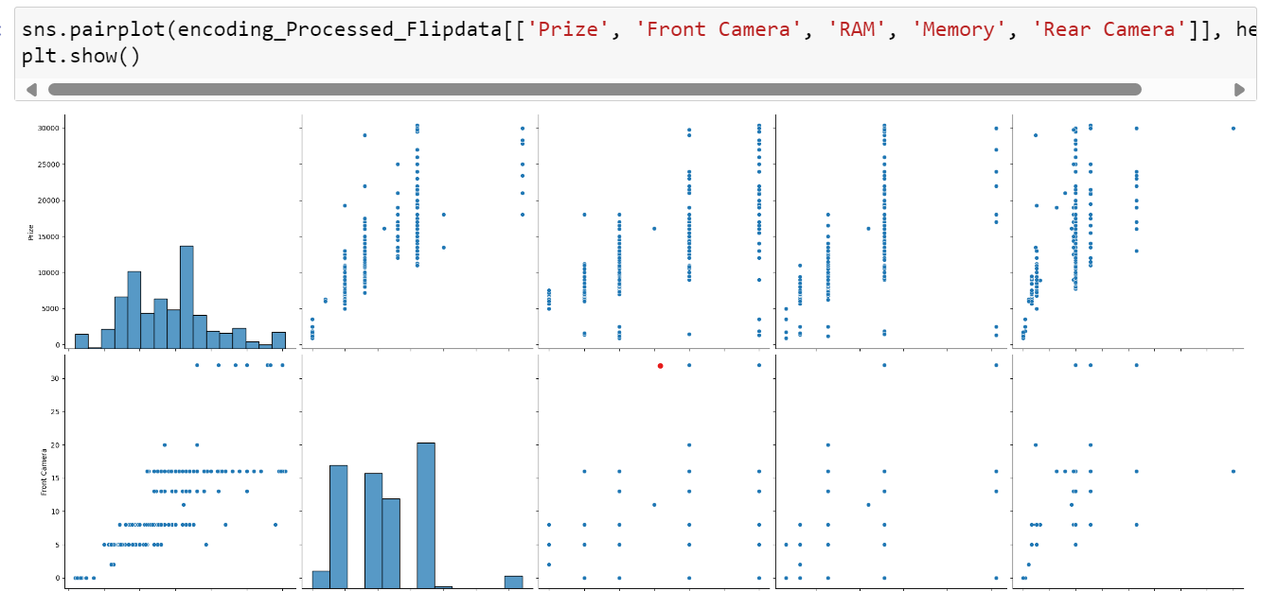
(2). Pairplot:

Slide 17
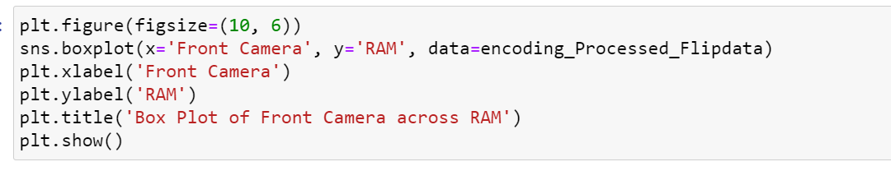
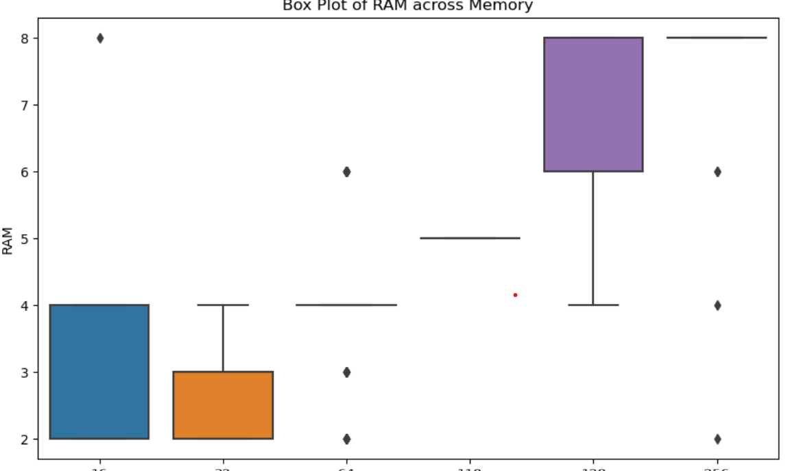
(3). Boxplot:

Slide 18
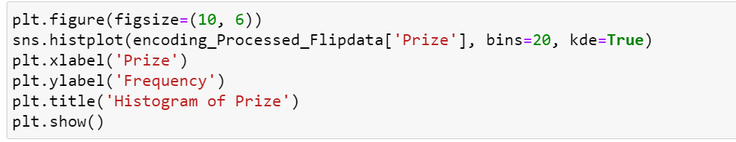
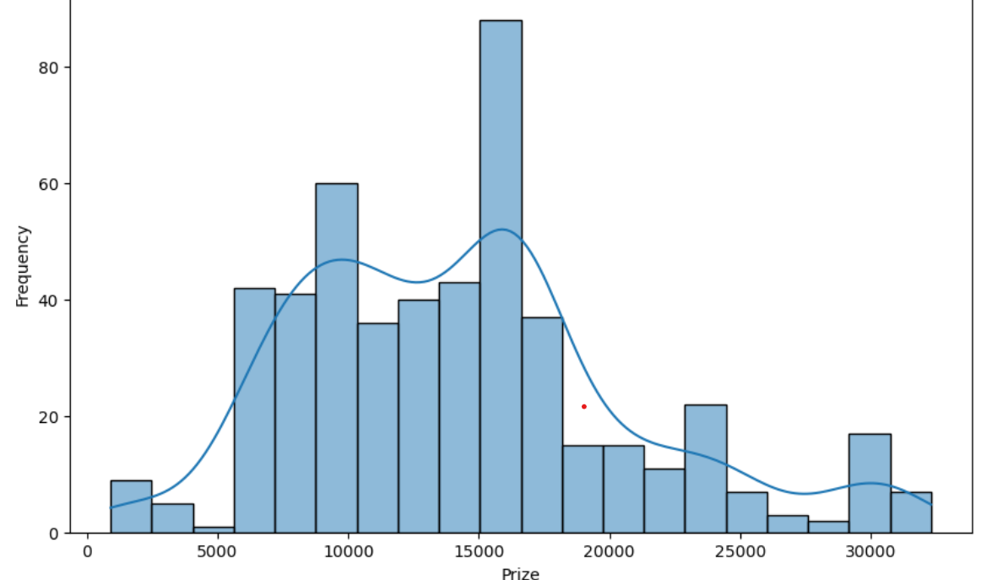
(4). Histogram:

Slide 19
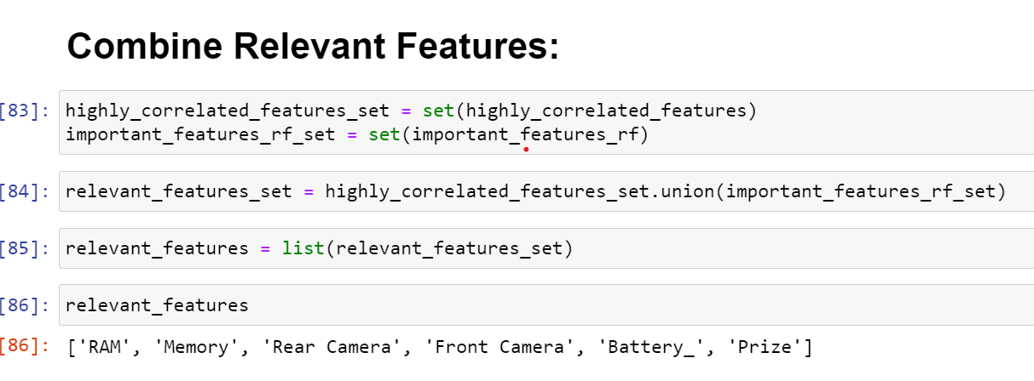
(c). Feature Importance Techniques:
Use feature selection methods such as Recursive Feature Elimination (RFE), SelectKBest, or tree-based feature selection (e.g., RandomForestRegressor.feature_importances_ or ExtraTreesRegressor.feature_importances_) to rank features based on their importance.

Slide 20
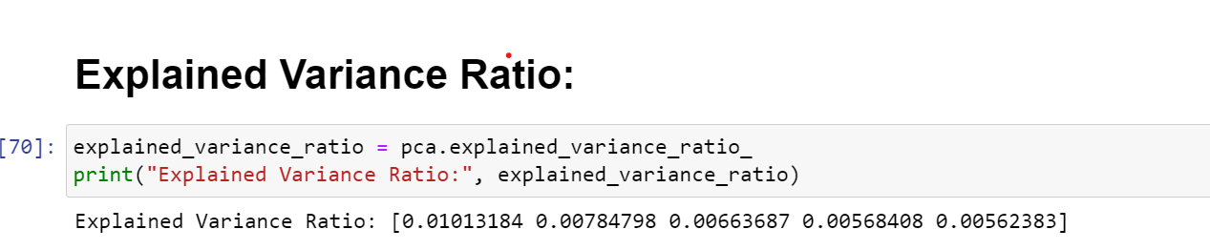
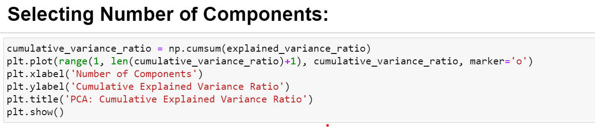
Apply dimensionality reduction techniques such as Principal Component Analysis (PCA) to reduce the number of features while retaining the most important information.

Slide 21
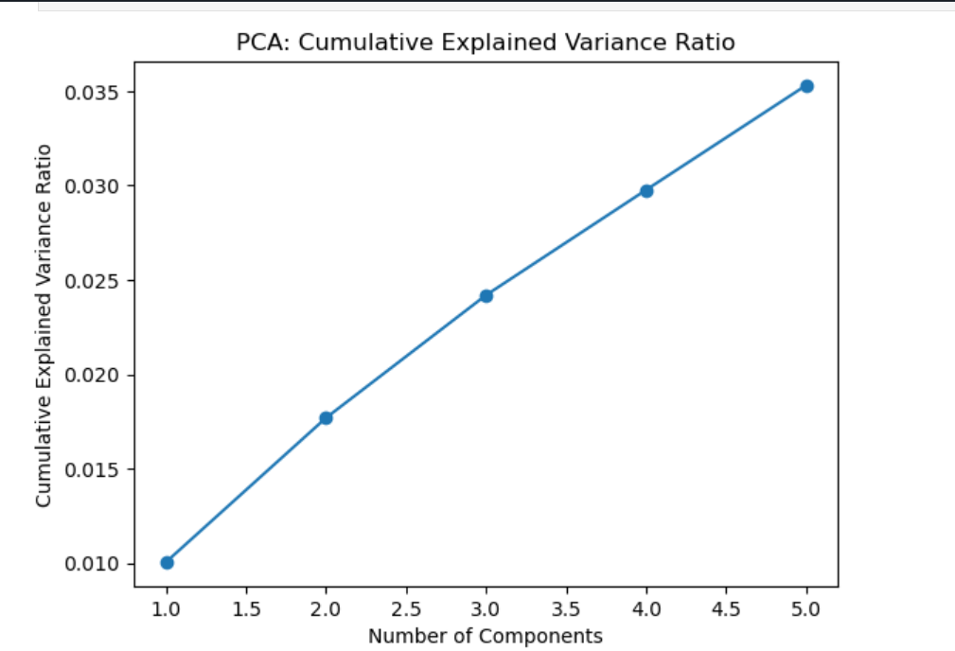

Slide 22
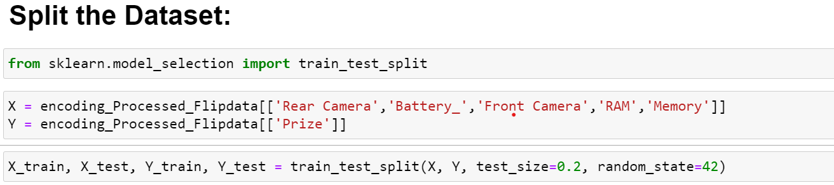
(iv). Model Building:
To build a machine learning model for price prediction using the Processed_Flipdata dataset, you can follow these steps.
(a). Split the Dataset:
Split the dataset into training and testing sets using the ‘train_test_split’ function from ‘sklearn.model_selection’.

Slide 23
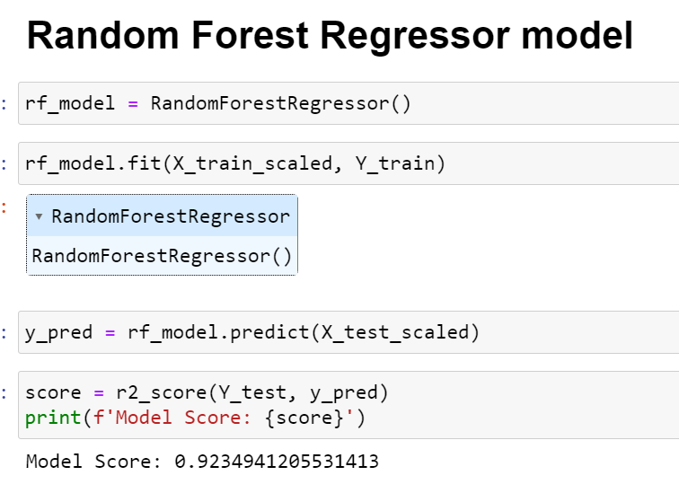
(b). Choose a Model:
Select a machine learning algorithm for price prediction. Common choices include:
Random Forests:
from ‘sklearn.ensemble’ import ‘RandomForestRegressor’.

Slide 24
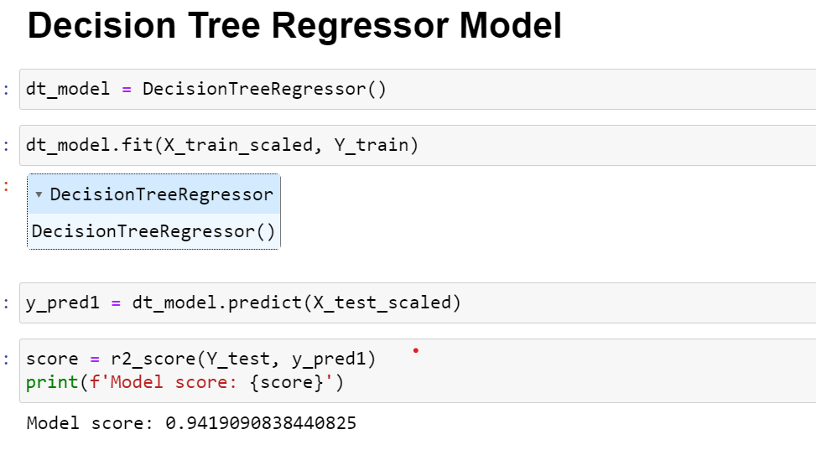
Decision Trees:
from ‘sklearn.tree’ import ‘DecisionTreeRegressor’.

Slide 25
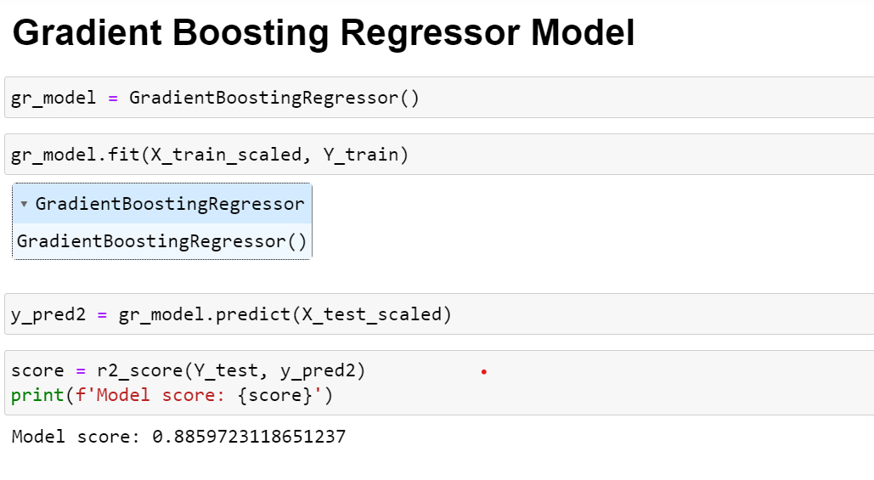
Gradient Boosting:
from ‘sklearn.ensemble’ import ‘GradientBoostingRegressor’.

Slide 26
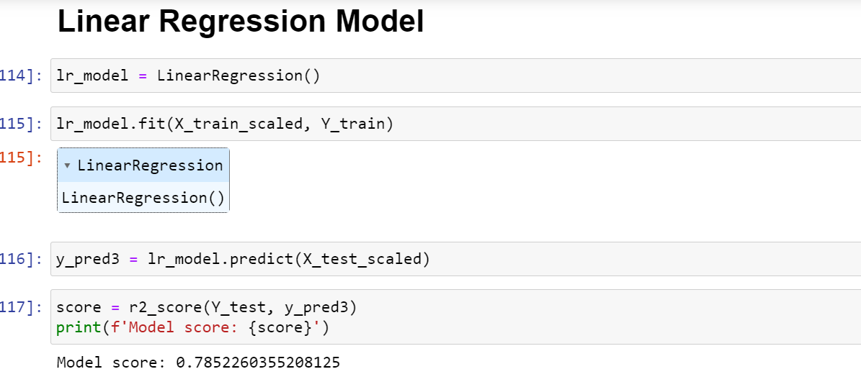
Linear Regression:
from ‘sklearn.linear_model’ import ‘LinearRegression’.

Slide 27
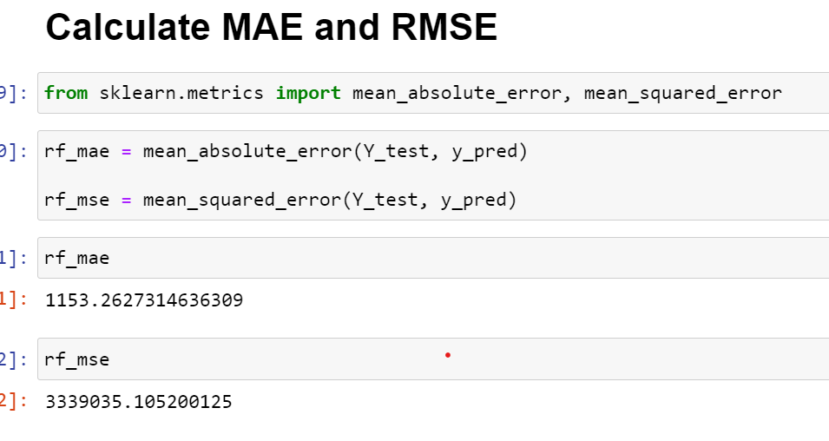
(v). Evaluate the Model:
Evaluate the model's performance using metrics such as Mean Absolute Error (MAE), Mean Squared Error (MSE), or R-squared.
Random Forests:

Slide 28
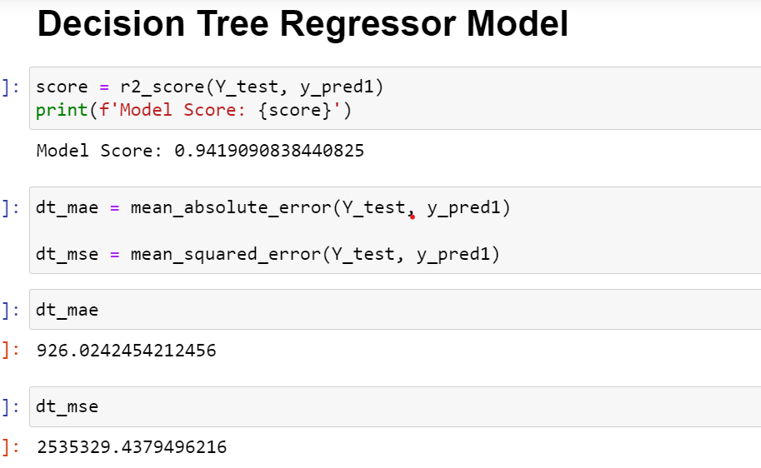
Decision Trees:

Slide 29
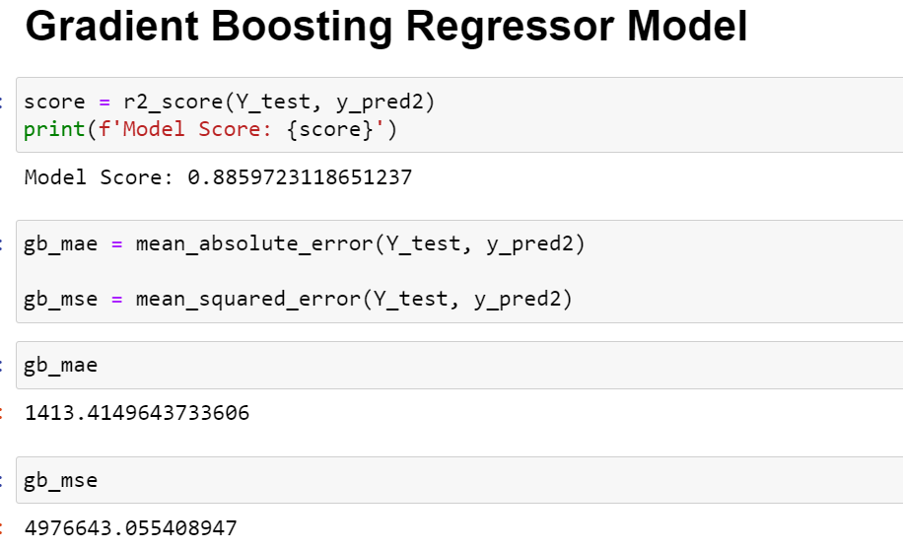
Gradient Boosting:

Slide 30
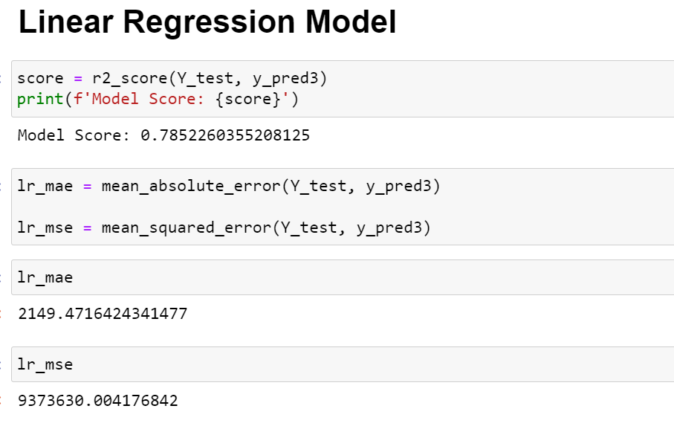
Linear Regression:

Slide 31
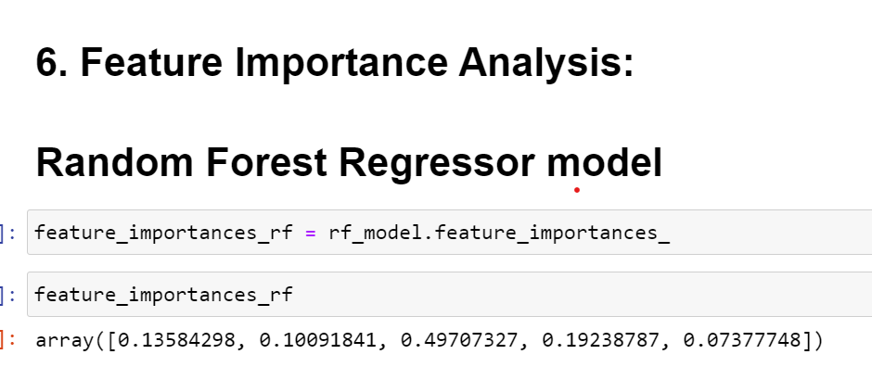
(vi). Feature Importance Analysis:
To analyze the feature importances obtained from your machine learning model and confirm the significance of the features identified during the feature extraction phase, you can follow these steps:
(a). Get Feature Importances:
For models like Random Forest, you can directly access feature importances using the ‘feature_importances_’ attribute.

Slide 32
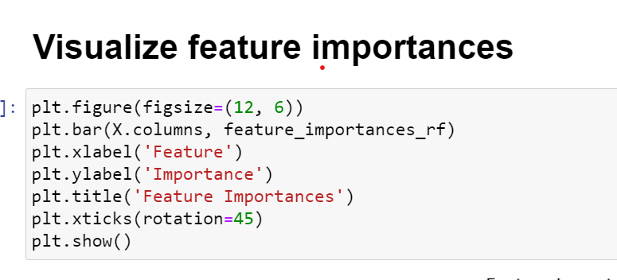
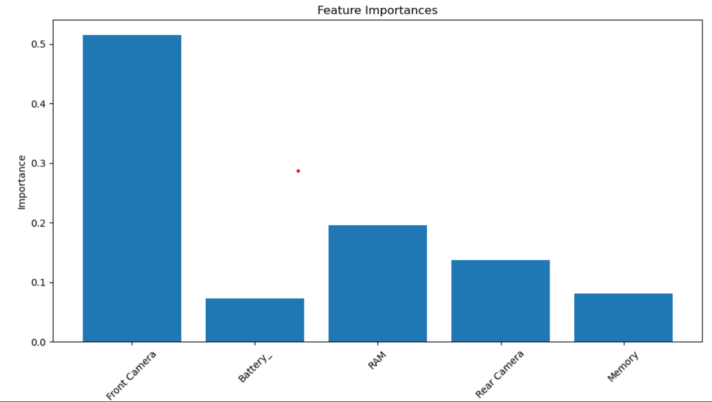
Visualize Feature Importances:

Slide 33
(vii). Report and Visualization:
(a).Introduction:
The goal of this project is to predict the prices of mobile phones based on various features such as model,color, memory, RAM, battery capacity, camera specifications, AI lens presence, mobile height, and processor type. The dataset used for this analysis is the "Processed_Flipdata" dataset, which contains information about these features as well as the corresponding prices of the mobile phones.
(b).Techniques and Models Used:
To analyze and predict mobile phone prices, we employed several techniques and models, including:
1. Data Cleaning and Preprocessing:
We cleaned the dataset by handling missing values, removing duplicates, and encoding categorical variables (e.g., color, model) into numerical representations suitable for modeling.

Slide 34
2. Exploratory Data Analysis (EDA):
We performed EDA to gain insights into the distribution of the target variable (price) and the relationships between features and price. This helped us understand the dataset better and identify important features for prediction.
3. Feature Importance Analysis:
Using techniques like Random Forest Regressor, we analyzed the importance of features in predicting mobile phone prices. This allowed us to identify the most influential features that impact price prediction.
4. Model Building and Evaluation:
We built regression models such as Linear Regression, Decision Tree Regression, and Random Forest Regression to predict mobile phone prices. We evaluated these models using metrics like R-squared, Mean Absolute Error (MAE), and Mean Squared Error (MSE) to assess their performance.

Slide 35
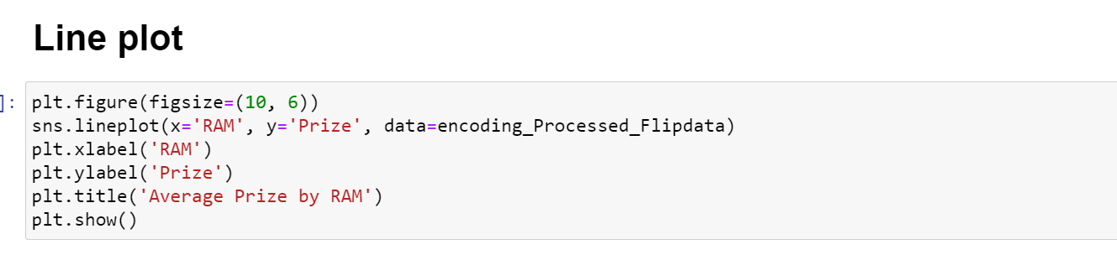
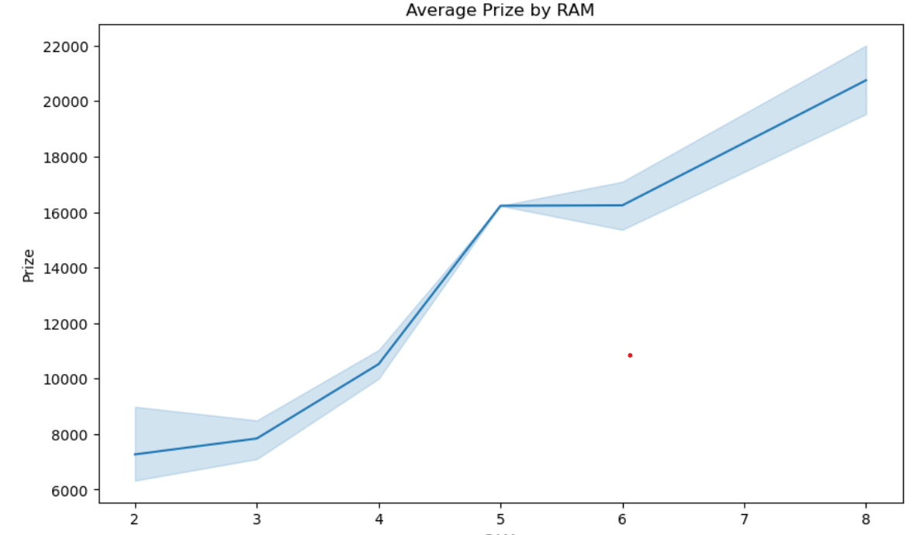
(c). Visualization:

Slide 36
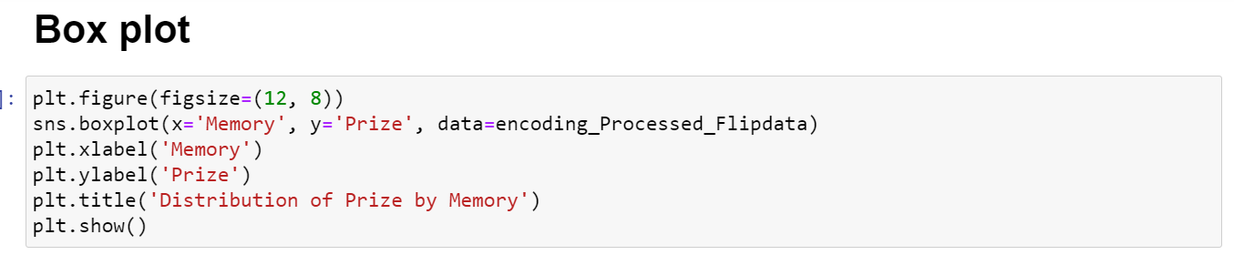
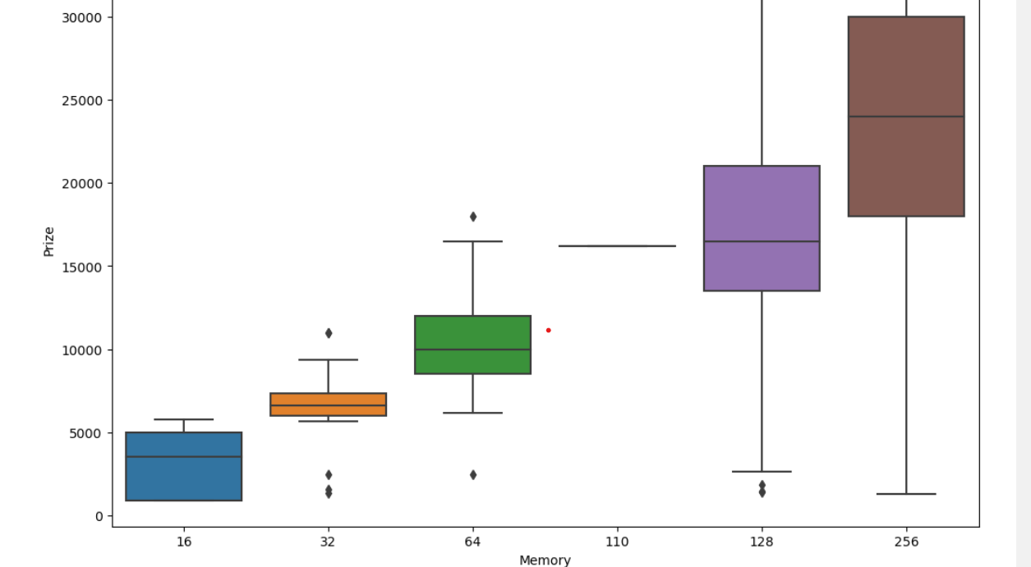

Slide 37
(viii). Recommendations:
Based on our analysis, we recommend the following insights to the organization regarding the features that have the most significant influence on mobile phone prices:
1. Front Camera , Memory and RAM:
Front Camera , memory and RAM have a strong positive correlation with mobile phone prices. Phones with Front Camera, higher memory and RAM capacities tend to command higher prices in the market. Therefore, focusing on offering phones with Front Camera , higher memory and RAM configurations can justify premium pricing.
2. Processor Type:
The processor type also plays a crucial role in determining the price of a mobile phone. Phones with high-performance processors are perceived as more powerful and desirable, leading to higher prices. Investing in smartphones with the latest and most powerful processors can help maintain a competitive edge in the market.

Slide 38
3. Camera Specifications:
Camera specifications, including rear and front camera resolutions, play a significant role in influencing mobile phone prices. Phones with better camera specifications are often priced higher, as they cater to consumers' increasing demand for high-quality photography and video capabilities.
4. Battery Capacity:
Battery capacity is another important factor affecting mobile phone prices. Phones with larger battery capacities tend to be priced higher, as they offer longer battery life and better overall performance. Emphasizing smartphones with long-lasting batteries can be a key selling point for premium pricing.
5. AI Lens and Other Advanced Features:
Advanced features such as AI lens technology can also impact mobile phone prices. These features enhance the overall user experience and differentiate smartphones from competitors. Highlighting these advanced features in marketing strategies can justify higher price points.

Slide 39
Chapter - 4
4. Results:
To write the results of your analysis using the Processed_Flipdata dataset, you can structure your report in a clear and concise manner. Here's an example of how you might write the results:
Dataset Overview:
Number of Samples: [insert number of samples].
Number of Features: [insert number of features].
Target Variable: 'Prize‘.

Slide 40
Summary Statistics:
Mean 'Memory': [insert mean value]
Mean 'RAM': [insert mean value]
Mean 'Battery_': [insert mean value]
Mean 'Rear Camera': [insert mean value]
Mean 'Front Camera': [insert mean value]
Mean 'AI Lens': [insert mean value]
Mean 'Mobile Height': [insert mean value]
Mean 'Processor_': [insert mean value]
Mean 'Prize': [insert mean value]

Slide 41
Key Findings:
The most important features for predicting mobile phone prices are 'RAM', 'Memory', 'Rear Camera', 'Battery_', 'Processor_', 'Front Camera', 'AI Lens', and 'Mobile Height'.
Mobile phones with higher RAM, memory, and camera resolutions tend to have higher prices.
The type of processor and battery capacity also play significant roles in determining the price of a mobile phone.
The specific model and color of a mobile phone do not seem to have a significant impact on its price, compared to other features.
A Random Forest model was used to predict mobile phone prices, achieving a mean squared error of [insert MSE value].

Slide 42
Chapter - 5
5. Conclusions:
Features like Front Camera , Memory and RAM are having strong relation with the target variable.
2. The best performing model is Random Forest Regressor Model with highest R2 & Adjusted_R2 Scores.
3. The second best performing model is Gradient Boosting Regressor Model.
4. The stacked model performance was impressive becuase of hight accuracy and low error rates.
5. The project developed a phones price prediction model with strong performance metrics.
6. The project effectively addresses the task of phone price prediction and contributes as a valuable tool in the dynamic real estate industry.

